Slide 1
SYLLABUS
Read through the syllabus and then answer the following questions on the response sheet:
What are the class behavior expectations?
What should you do if you are absent and miss a day of class?
What is the cell phone and ear bud policy?
Why is food not allowed in our science classroom?
What is your teacher’s science website?
What is considered cheating? What is the consequence for cheating?
**WHEN FINISHED, discuss with your group members: What do you think is the most important thing to remember from the syllabus?

Slide 2
Name: __________________________ Period:_____
Response Sheet
Record your answers for station one below:
1. _____________________________________________
2. _____________________________________________
3. _____________________________________________
4. _____________________________________________
5. _____________________________________________
6. _____________________________________________

Slide 3
GOAL-SETTING
This year your report card will look very different. You will be graded on specific skills related to our class for each unit we study. Read through the new grade reporting categories. For each one, rate yourself using the following scale as a guideline. Then, set a GOAL for that grade category. For each category, provide explain your self-evaluation/goal. When finished, discuss your goals with your peers.
Level | Description
Mastery | I can do this skill in advanced way every time without help. I can teach this to someone else with confidence.
Proficient | I can successfully do this skill.
Approaching | I can somewhat do this skill, but I need to improve to fully master it.
Beginning | I struggle with this skill and need help to master it.

Slide 4
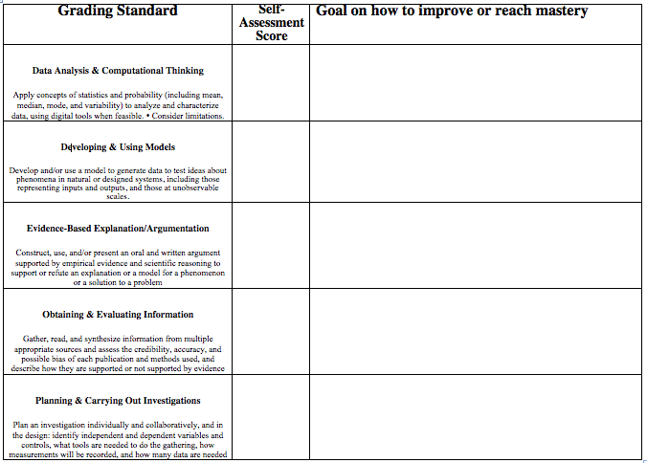
GOAL-SETTING

Slide 5
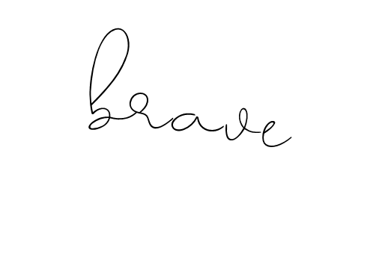
ONE WORD
Pick ONE word to describe your goals, dreams, and hopes for the 2019-2020 school year. JUST. ONE. WORD. This should be a word that you want to keep in your mind throughout the year, a word that can serve as a simple reminder for your purpose and your goals. Make sure it is a word that holds unique meaning to YOU, not a word that conveys something that others/society want from you. Deliberately choose your word for the year; then, write and visually represent it on a sheet of blank paper -OR- use one of the provided templates. You may use words/phrases, images, etc. Make it meaningful to YOU. It doesn’t matter if its decipherable to anyone else, but you should be able to explain it. Some examples are below, but try your best to think of your own word! WHEN FINISHED, share your words with your group members.

Slide 7
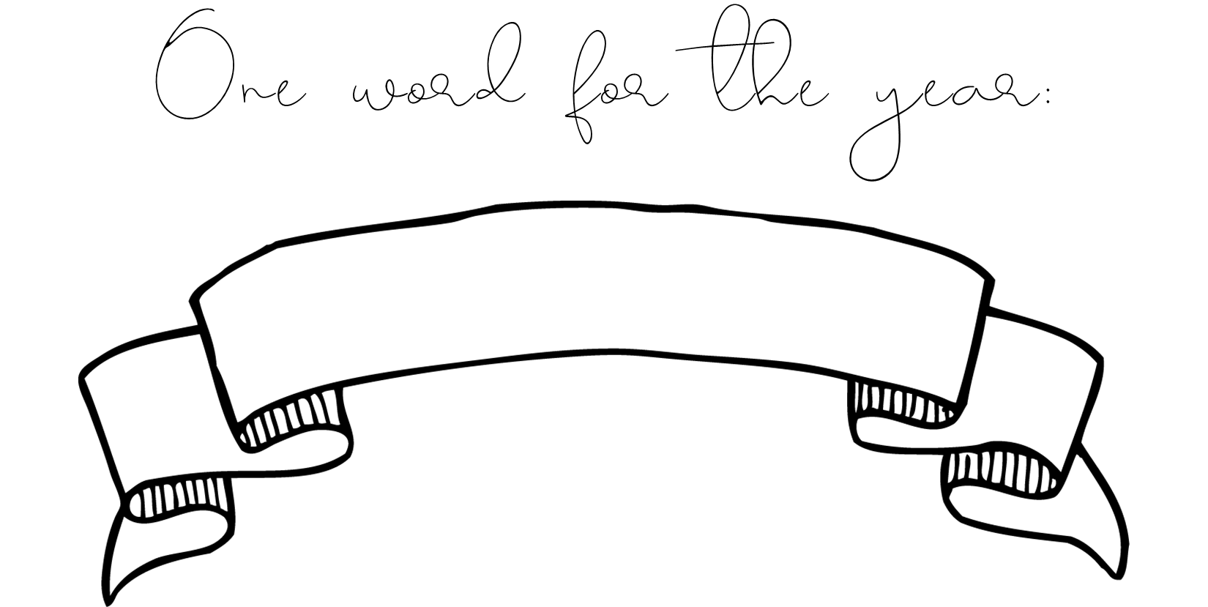

Slide 8
SURVEY
FIRST, Join Google Classroom with the code for your class period:
1st Period: 1jfrjm 2nd Period: qljgf0u 3rd Period: fkq3gkm
4th Period: wq43oye 6th Period: evk3qsj
THEN, go to the “Student Survey” Google form linked on Classroom. Complete this survey.
WHEN YOU ARE FINISHED, share what you hope to learn this year with your small group.

Slide 9
SELFIE PADLET
FIRST, Join Google Classroom with the code for your class period:
1st Period: 1jfrjm 2nd Period: qljgf0u 3rd Period: fkq3gkm
4th Period: wq43oye 6th Period: evk3qsj
THEN, go to the “Get-to-know-you” Padlet linked on Classroom. From there, you will need to take a selfie and describe what you do in your spare time, what you did over the summer, and any other fun facts you want your teacher/peers to know.
WHEN YOU ARE FINISHED, get to know your classmates by looking through their selfies and reading their captions.

Slide 10
Pre-Assessment
FIRST, Join Google Classroom with the code for your class period:
1st Period: 1jfrjm 2nd Period: qljgf0u 3rd Period: fkq3gkm
4th Period: wq43oye 6th Period: evk3qsj
THEN, go to the “Science Pre-Assessment” Google form linked on Classroom. Complete this quiz.

Slide 11
Name: ________________________________________________________ Date: _________________ Period: ____________
STATION 1 | STATION 2
_______________________________________________________________________________________________________________________________________________________________________________________________________________________________________________________________________________________________________________________________________________________________________________________________________________________________________________________________________________________________________________________________________________________________________________________________________________________________________________________________________________________________________________________________________________________________________________________________________________________________________________________________________________________________________________________________________________________________________________________________________________________________________________________________________________________________________________ | _____________________________________________________________________________________________________________________________________________________________________________________________________________________________________________________________________________________________________________________________________________________________________ __________________________________________________________________________________________________________________________________________________________________________________________________________________________________________________________________________________________________________________________________________________________________________________________________________________________________________________________________________________________________________________________________________________________________________________________________________________________________________________________________________________________________________________________________________

